Slide 1
Unit 6 Assignment 1
By Simon light

Slide 2
Contents
I will explain the differences between and typical uses of :
Object-Orientated
Procedural
Event Driven
I will also explain Scripted and Mark-up languages.
I will also look into how to choose the right language for your needs.

Slide 3
P1

Slide 4
Object Orientated (OO)
Object orientated runs of chunks of code called ‘objects’.
Within an object there are fields, which contain data, and methods, which contains code.
Objects can edit the data within the fields with commands such as ‘this’ and ‘self’.
As is apparent OO programming is the interaction of objects.
Popular versions of OO are class based, meaning that objects are classes in the code which also depicts the type of object it is.

Slide 5
OO : Draw -backs
The Major drawbacks of OOP are :
Size : the whole size of the file is much larger. This means on older, smaller or more efficient system it will be a large dent to performance.
Speed : due to the size and resources that the program uses the speed of the program is limited.
Development : a great deal of planning needs to go into OOP before you start coding it. This means a lot more time is spent on development so the outcome is more costly.

Slide 6
OO : languages
Python
C++
Objective-C
Smalltalk
Delphi
Java
Swift
C#
Perl
Ruby
PHP

Slide 7
OO : Typical uses
OOP can be used in a wide range of areas. It is less where it can and can’t be used but more where it should and shouldn’t be used.
Some examples of places OOP shouldn’t be used are :
Compilers - representing ASTs and graphs; Pattern matching does not go well with OOP.
Most of the numeric and symbolic mathematics - functional approach fits better.
Business rules - logic/constraint programming is a much better fit here
Anything that can be expressed as a state machine
Anything that can be expressed in a dataflow semantics. OOP does not fit it at all.
Anything that is better expressed using the term rewriting systems.

Slide 8
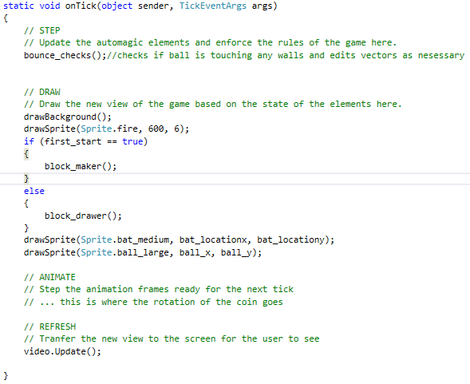
OO : Example
This is where I am calling a class within the onTick class. That will make the code within those classes run and then it will run the next line in onTick.
This is my code for a simple Atari Breakout game. The Class ‘onTick’ is called 60 times a second as the game is running at 60FPS. When the class is called, it runs all of the code within it.
This is a class that takes an input, (the things inside the brackets. In this case it draws the sprite ‘fire’ at the coordinates (600, 6).
These ‘{‘ ‘}’ mean the start and end of the class onTick.

Slide 9

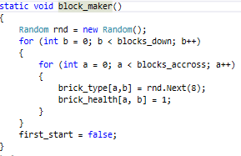
OO : Example
This is the class of ‘block_maker’ which was called in the ‘onTick’ class.
The code first of all creates a random number. It then runs a statement called ‘for’ which is a loop. The parameters in the brackets say “the variable that we are using is b and it is equal to 0; loop while b < blocks_down which is equal to 3; each time this loops, add 1 to the value of b”
Its type is a void which is a special variable as the class does not return a value, so the value it returns is ‘void’ / nothing.
This is assigning the value of ‘false’ to the value of ‘first_start’.

Slide 10

OO : Example
The class ‘drawSprite’ which means that when it is called it takes an input as shown. The class will then use that input and return a value. In this case the class returns ‘void’ meaning nothing. In this class the inputs are used to depict which sprite you want to draw and where.

Slide 11
Procedural Programming (PP)
Procedural programming is based upon the calling of procedures/routines and subroutines.
In this way it is similar to OO but it differs in the fact that the routines do not contain data and can be called from anywhere in the program.
Routines may be called anywhere in the program including itself and other routines/subroutines.

Slide 12
PP : Draw -backs
It emphasis on doing things. Data is given a second class status even through data is the reason for the existence of the program.
Since every function has complete access to the global variables, the new programmer can corrupt the data accidentally by creating function. Similarly, if new data is to be added, all the function needed to be modified to access the data.
It is often difficult to design because the components function and data structure do not model the real world.

Slide 13
PP : languages
Some of the common PP languages include :
C
GO
Fortran
Pascal
BASIC

Slide 14
PP : Typical Uses
PP should mainly be used if you want to run something over and over or in the background.
PP is also good for splitting a program up into chunks that happen a lot e.g. every time you come home you open the front door, walk through it and then close it. This happens every day so could be placed into a procedure that is called every time you come home.

Slide 15
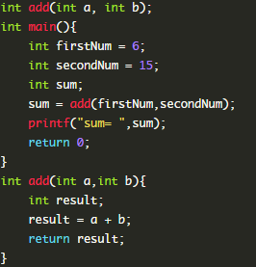
PP : Example
Main then calls the procedure of ‘add’ and places the two variables created into it. This makes the code jump to the point of the procedure ‘add’.
Here is a simple addition program that I made in the language C.
The ‘add’ procedure then creates a variable called ‘result’. It then assigns the value of the sum of the two numbers entered to result. It then returns result.
The procedure ‘main’ will always run first in C. It then assigns two variables the values of 6 and 15. it also creates another variable of sum.
The code then jumps back to after the procedure being called. This then prints the result of ‘add’ with a variable called sum. The program then ends.

Slide 16
Event Driven
Event driven programming is all done of events (as is apparent)
An event could include:
A keyboard press
A mouse press
Voice
Device event (low battery/storage full)

Slide 17
Event drive : drawbacks
Classes are often not reusable or hard to implement in other applications.
Event Driven Programming is generally only useful in GUI programming
Event Driven Programming is complex to master
Is often not portable to other operating systems, such as in the case of the .NET framework under windows that uses event driven programming.
For simple programs, event driven programming is often more complex and cumbersome than batch programming.
The flow of the program is usually less logical and obvious.

Slide 18
Event driven : languages
Visual Basic
C#
VBA
Java
ColdFusion
JavaScript
HTML

Slide 19
Event driven : Typical uses
Pretty much anything that follows the paradigms flow.
Operations that happen on a user input
Operation that happen on a devices events
Operations that happen from sensor readouts
Anything other than this doesn't follow the paradigm and so is not effective in event driven

Slide 20
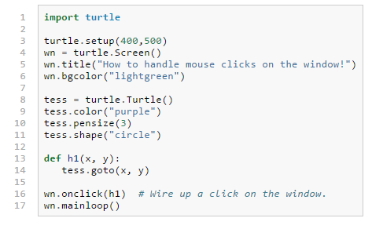
Event driven: Example
Here is an example of event driven programming in HTML. It moves a turtle to the position of your mouse when you click.
This is the creation and setting up of the turtle on the screen.
This means “when the mouse is clicked, run ‘h1’.
This means go to the position of the mouse.

Slide 21
P2

Slide 22
Choosing the right language
Choosing the right language is very important when it comes to programming and is often one of the first things you do when starting a project. Here are some things you need to consider:
Is it actually practical for the use
Can it be used for the paradigm you need to use
Can it be used by the user
Is it compatible with files you need to supply it
Do you know it well enough to make what you need to
Do others in your team know it well enough
Are there pre-existing libraries available for what you want to do

Slide 23
Example 1 : IOS game
This is a good example of why you need to think about the end user.
Java may seem like a good choice here.
It is event driven
Is compatible with graphics
There are a lot of gaming libraries available.
Java is quite easy to learn and is very popular with programmers.
There is good reasoning to develop the game in Java and you may go forward with and then start testing.
This is when you realise that IOS cannot run Java functions and so will not be able to play the game.

Slide 24
Example 2 : Web Page
For a web page it is pretty obvious to most people that you would use HTML and I will show that it fits the requirements.
It is very popular
Has pre existing libraries
Is simple to pick up.
Is widely used across the internet to display web pages
Can have additional files/data put into it.
Has CSS to do graphics with other libraries

Slide 25
Example 3 : Desktop application
C# is a common used language and is chosen by Microsoft as their choice of desktop applications.
This is because:
Their whole team knows it.
It is compatible with their audience (windows users)
Has a lot of libraries
Has lots of file support (inc. txt, sql, JSON, XML .etc)
Is simple to create a good looking form

Slide 26
Example 4 : Text based calculator
Python is the most commonly learned language as a start up language. It is also very good for text based applications.
This means that there are a lot od libraries available for input/output
There are built in functions for addition, subtraction .etc.
Python is a very light weight language and so it is efficient for this style of program.
It can be put into and event driven paradigm.

Slide 27
Example 5 : Text file updater
Batch would be my first choice for this style of application
This is because:
It is very compatible with reading and writing to text files
Is less commonly known however very easy to pick up#
Can be run on any windows platform (very popular)
It is light weight and so will make the program vey efficient.
Can be run in the background so that it doesn’t effect the user.

Slide 28
Bibliography
https://en.wikipedia.org/wiki/Object-oriented_programming
https://en.wikipedia.org/wiki/Procedural_programming
http://radar.oreilly.com/2014/01/should-you-start-programming-with-a-procedural-language.html
http://www.sciencehq.com/computing-technology/procedural-oriented-programming.html
http://science.blurtit.com/701976/what-are-disadvantages-of-event-driven-programming
https://en.wikipedia.org/wiki/Event-driven_programming
http://openbookproject.net/thinkcs/python/english3e/events.html

